Slide 1
CSE 170 Technical Teamwork Fall 2024
Making you awesome – so you can be a better teammate.

Slide 2
Opening Prayer

Slide 3

Agenda
Self-Management
Emotional Self-Control
Assignments
Review assignments and due dates
Initial the roll
Motivation
Time Management
Overview
Announcements
Spiritual Thought

Slide 4


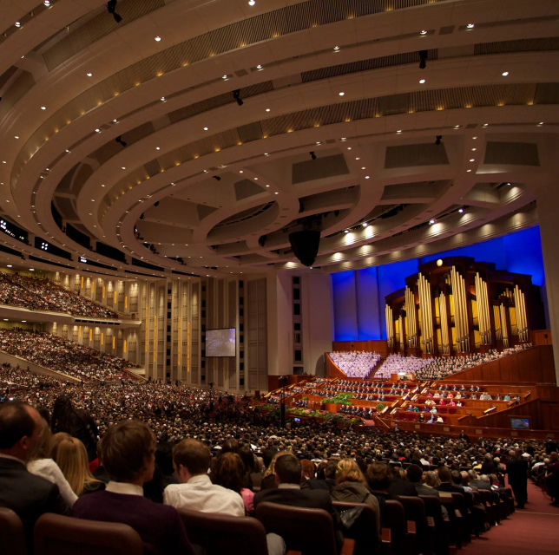

Spiritual Thought
What messages from General Conference were most meaningful to you?

Slide 5



Review
Equality of Distribution of Conversational Turn-Taking

Slide 6
Announcements
Tuesday, Thursday, Friday 3:30-6:30, STC375/385/394/384
Computing Society
CSE Volunteer Tutor Lab
Wednesday 5:00-5:30, STC375/385/394/384
Drop in for help with ANYTHING
Faculty Experience Expo
IEEE Resume Workshop
Tuesday 5:30-6:30
Wednesday 5:30-6:30
STC 341
SWE Technical Interview Workshop

Slide 7
Assignments
U02 Prove: Activity Log
Keep track of your daily activities for two days, then report your findings.
Due Saturday
U02 Prove: Vision Board (in class activity Wednesday)
Make a collage of your goals and aspirations and explain how self-management will help you get there.
Due Saturday

Slide 8
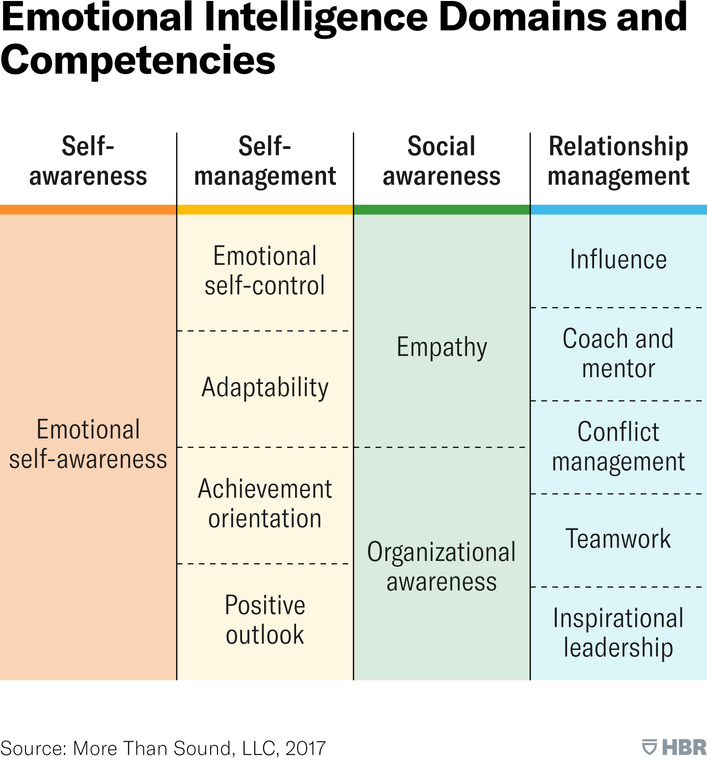
Emotional Intelligence

Slide 9

Self-Management or Self-Control
What does it mean to you to have self-control?
This Photo by Unknown Author is licensed under CC BY-NC-ND

Slide 10
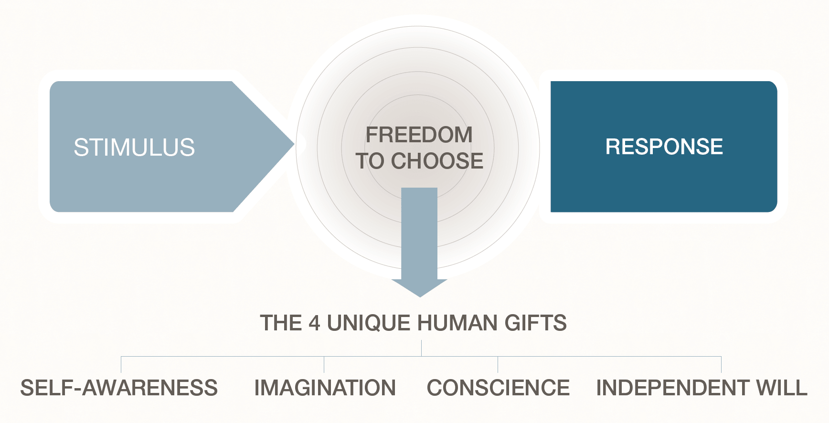
The Stimulus Gap

Slide 11

Emotional Regulation

Slide 12
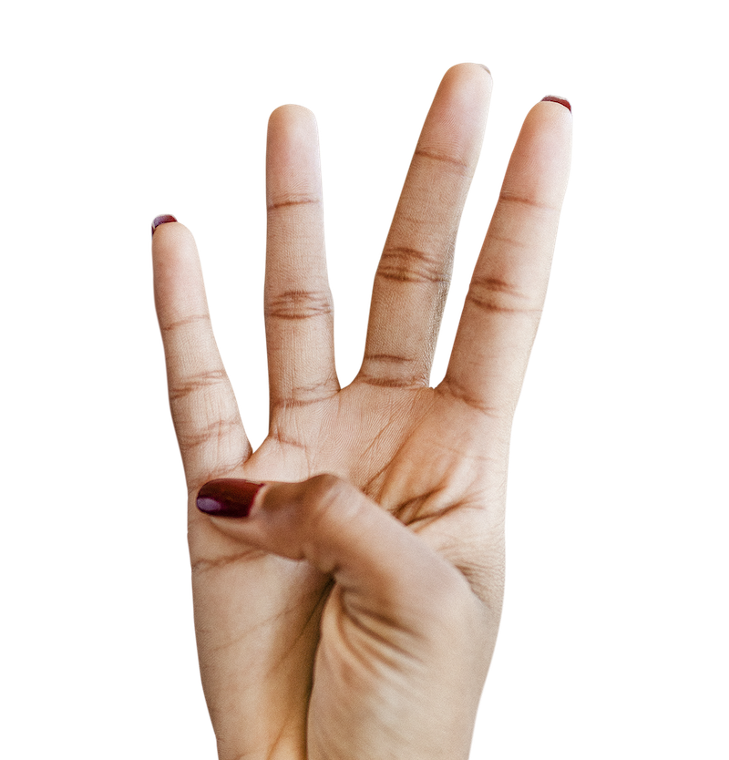
Impulse Control
When something happens that might provoke an automatic reaction, train yourself to wait 4 Seconds:
Count to four – 1, 2, 3, and 4 – then decide how to proceed
Doing this engages your “prefrontal cortex”, or the decision-making center of your brain.
Otherwise, your response is more automatic, and may not be best.
You might find yourself cleaning up the mess later!

Slide 13

Group Discussion
In your group, identify one of your “triggers” where you might need to learn to count to 4.
This Photo by Unknown Author is licensed under CC BY-SA-NC

Slide 14
Adaptability - Motivation
Intrinsic Motivation
Motivation through your own desire to improve.
Extrinsic Motivation
Motivation through external forces like rewards or penalties.
Which is better?

Slide 15
Motivators
Money
Personal Interest
Satisfaction of Mastery
Awards and Recognition
Competition
Curiosity
Autonomy
Grades

Slide 16
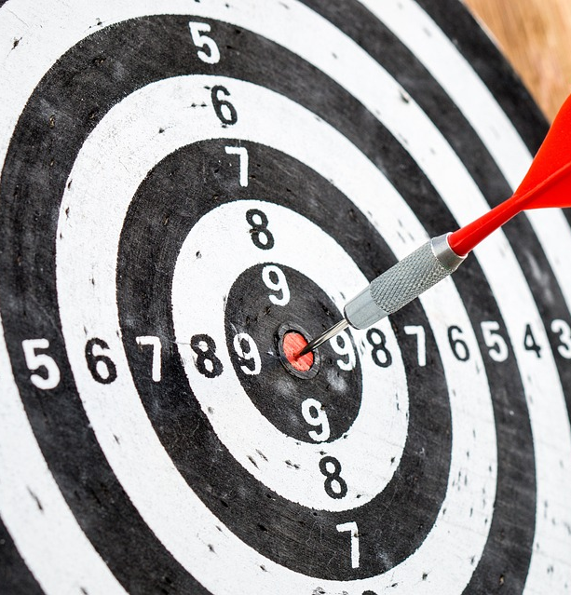
Improving Intrinsic Self-Motivation
Set Clear Goals for Yourself
Decide what you want to achieve and take steps in that direction.
Find Opportunities for Improvement
Allow self-refection to inform what you want to work on.
Discover Personal Relevance
Determine why things that you do or don’t do matter.
Celebrate Success
Share your success stories with people around you and celebrate your milestones.
Be Flexible
Recognize that life doesn’t always go according to plan. If what you are doing isn’t working find a new way forward
IN YOUR GROUP: Discuss which of these would work best for you.

Slide 17
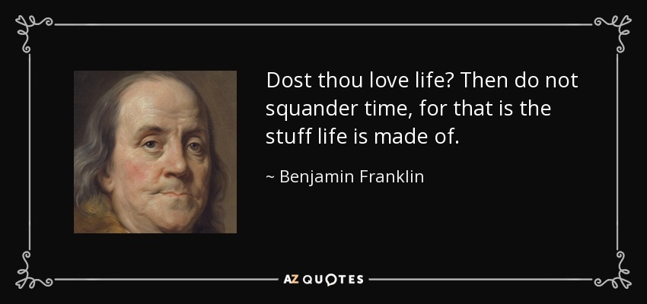
Adaptability - Time Management

Slide 18
Time Management Techniques
Eisenhower Matrix
Pomodoro Method
Time Blocking Method
Eat The Frog Method

Slide 19
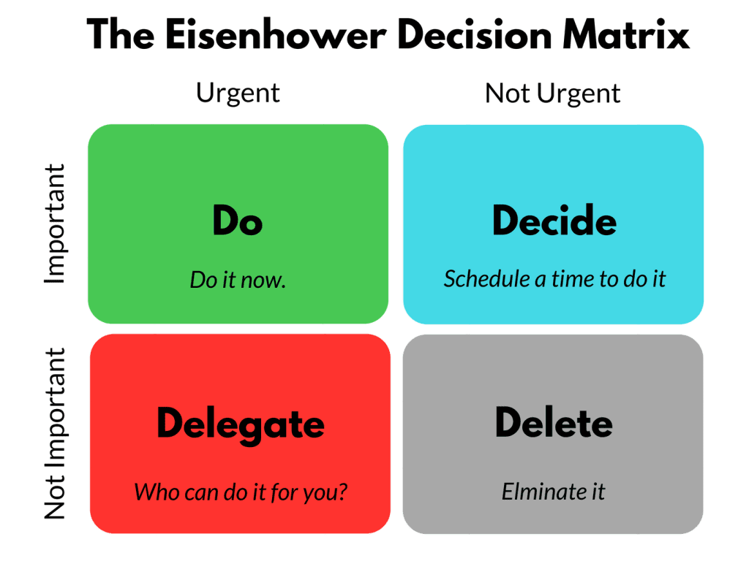
Eisenhower Matrix

Slide 20
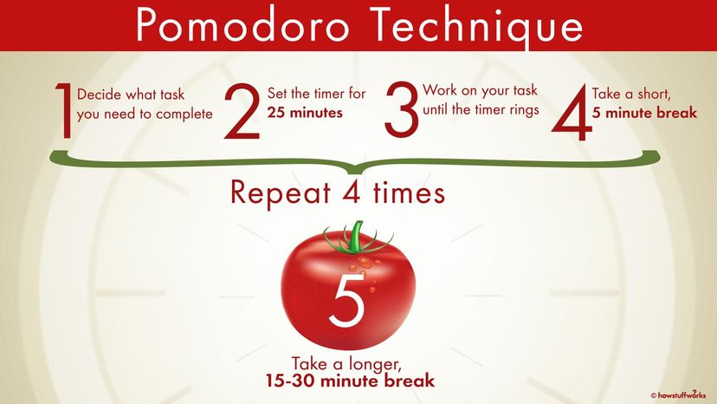
Pomodoro Method

Slide 21
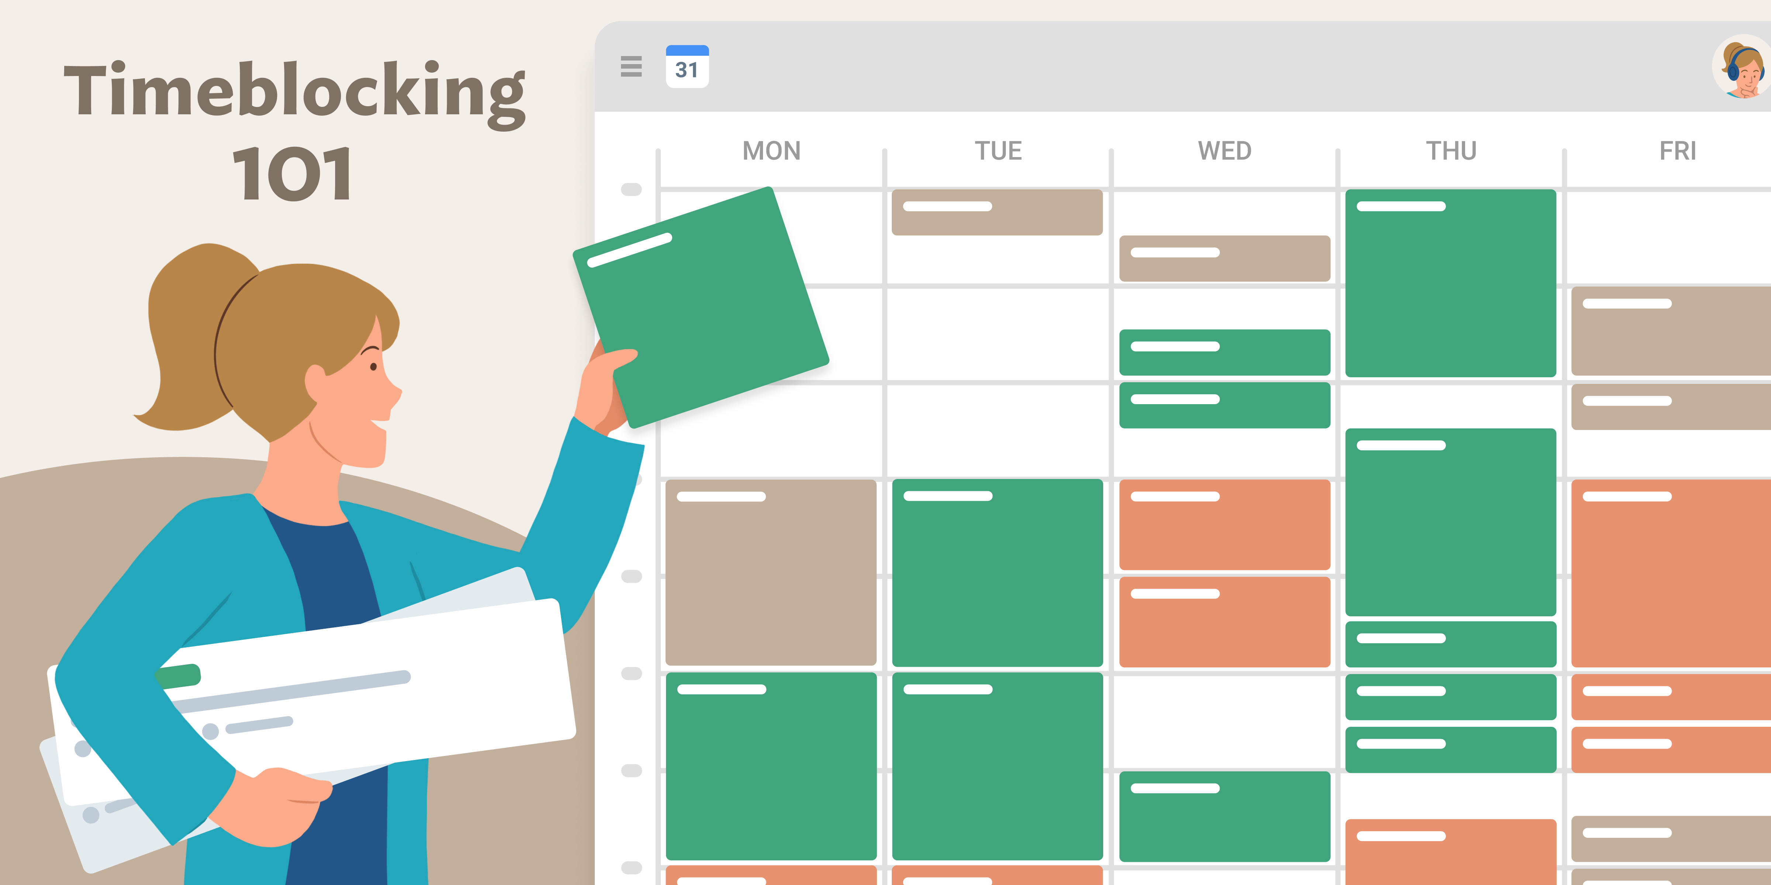
Time Blocking Method

Slide 22
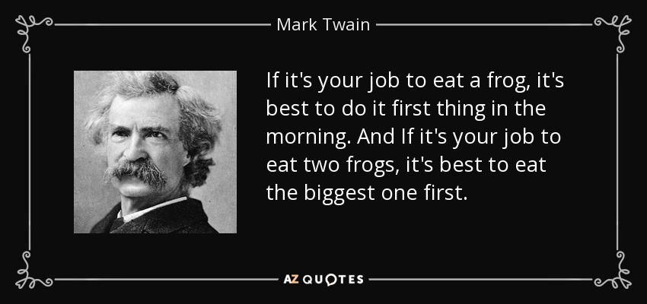

Slide 23
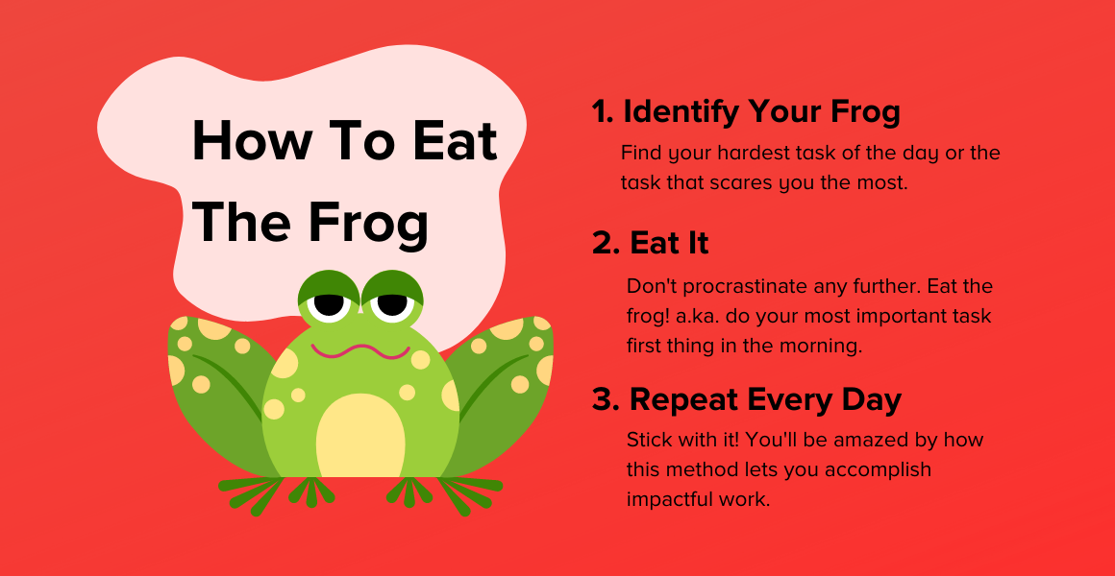
Eat The Frog Method

Slide 24

Group Discussion
Which of the time management techniques works has worked for you in the past?
Which do you want to try?

Slide 25
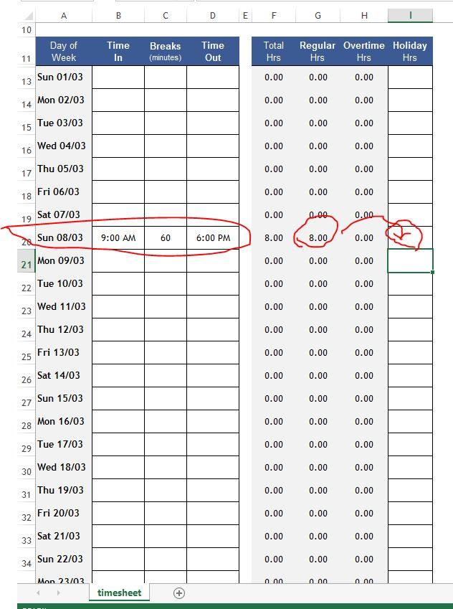
Activity Log
For the next 2 days keep track of your activities.
How long did you spend?
Was the activity engaging/interesting or boring?
Did the activity give you energy, or sap your energy?
Use the log provided.
Find it in the U02 Prove: Activity Log assignment
You can either take a picture of your completed written log, or you can download the log from the assignment and submit an electronic version.
Record your findings
When you submit your completed log, indicate two ways you could improve your use of time.
This Photo by Unknown Author is licensed under CC BY-SA

Slide 26
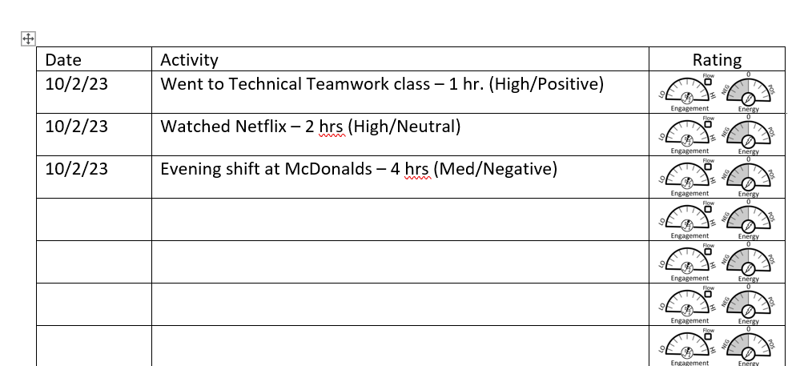
Activity Log - Example

Slide 27

Next Time
Positive Outlook
Habit Formation
Vision Boards – Goal Setting

